Slide 1

PITCH
DECK
INNOVATING FOR A GREATER SOLAR COMMUNITY PROJECT
PRESENTED BY SUNWORKS CI LIMITED

Slide 2
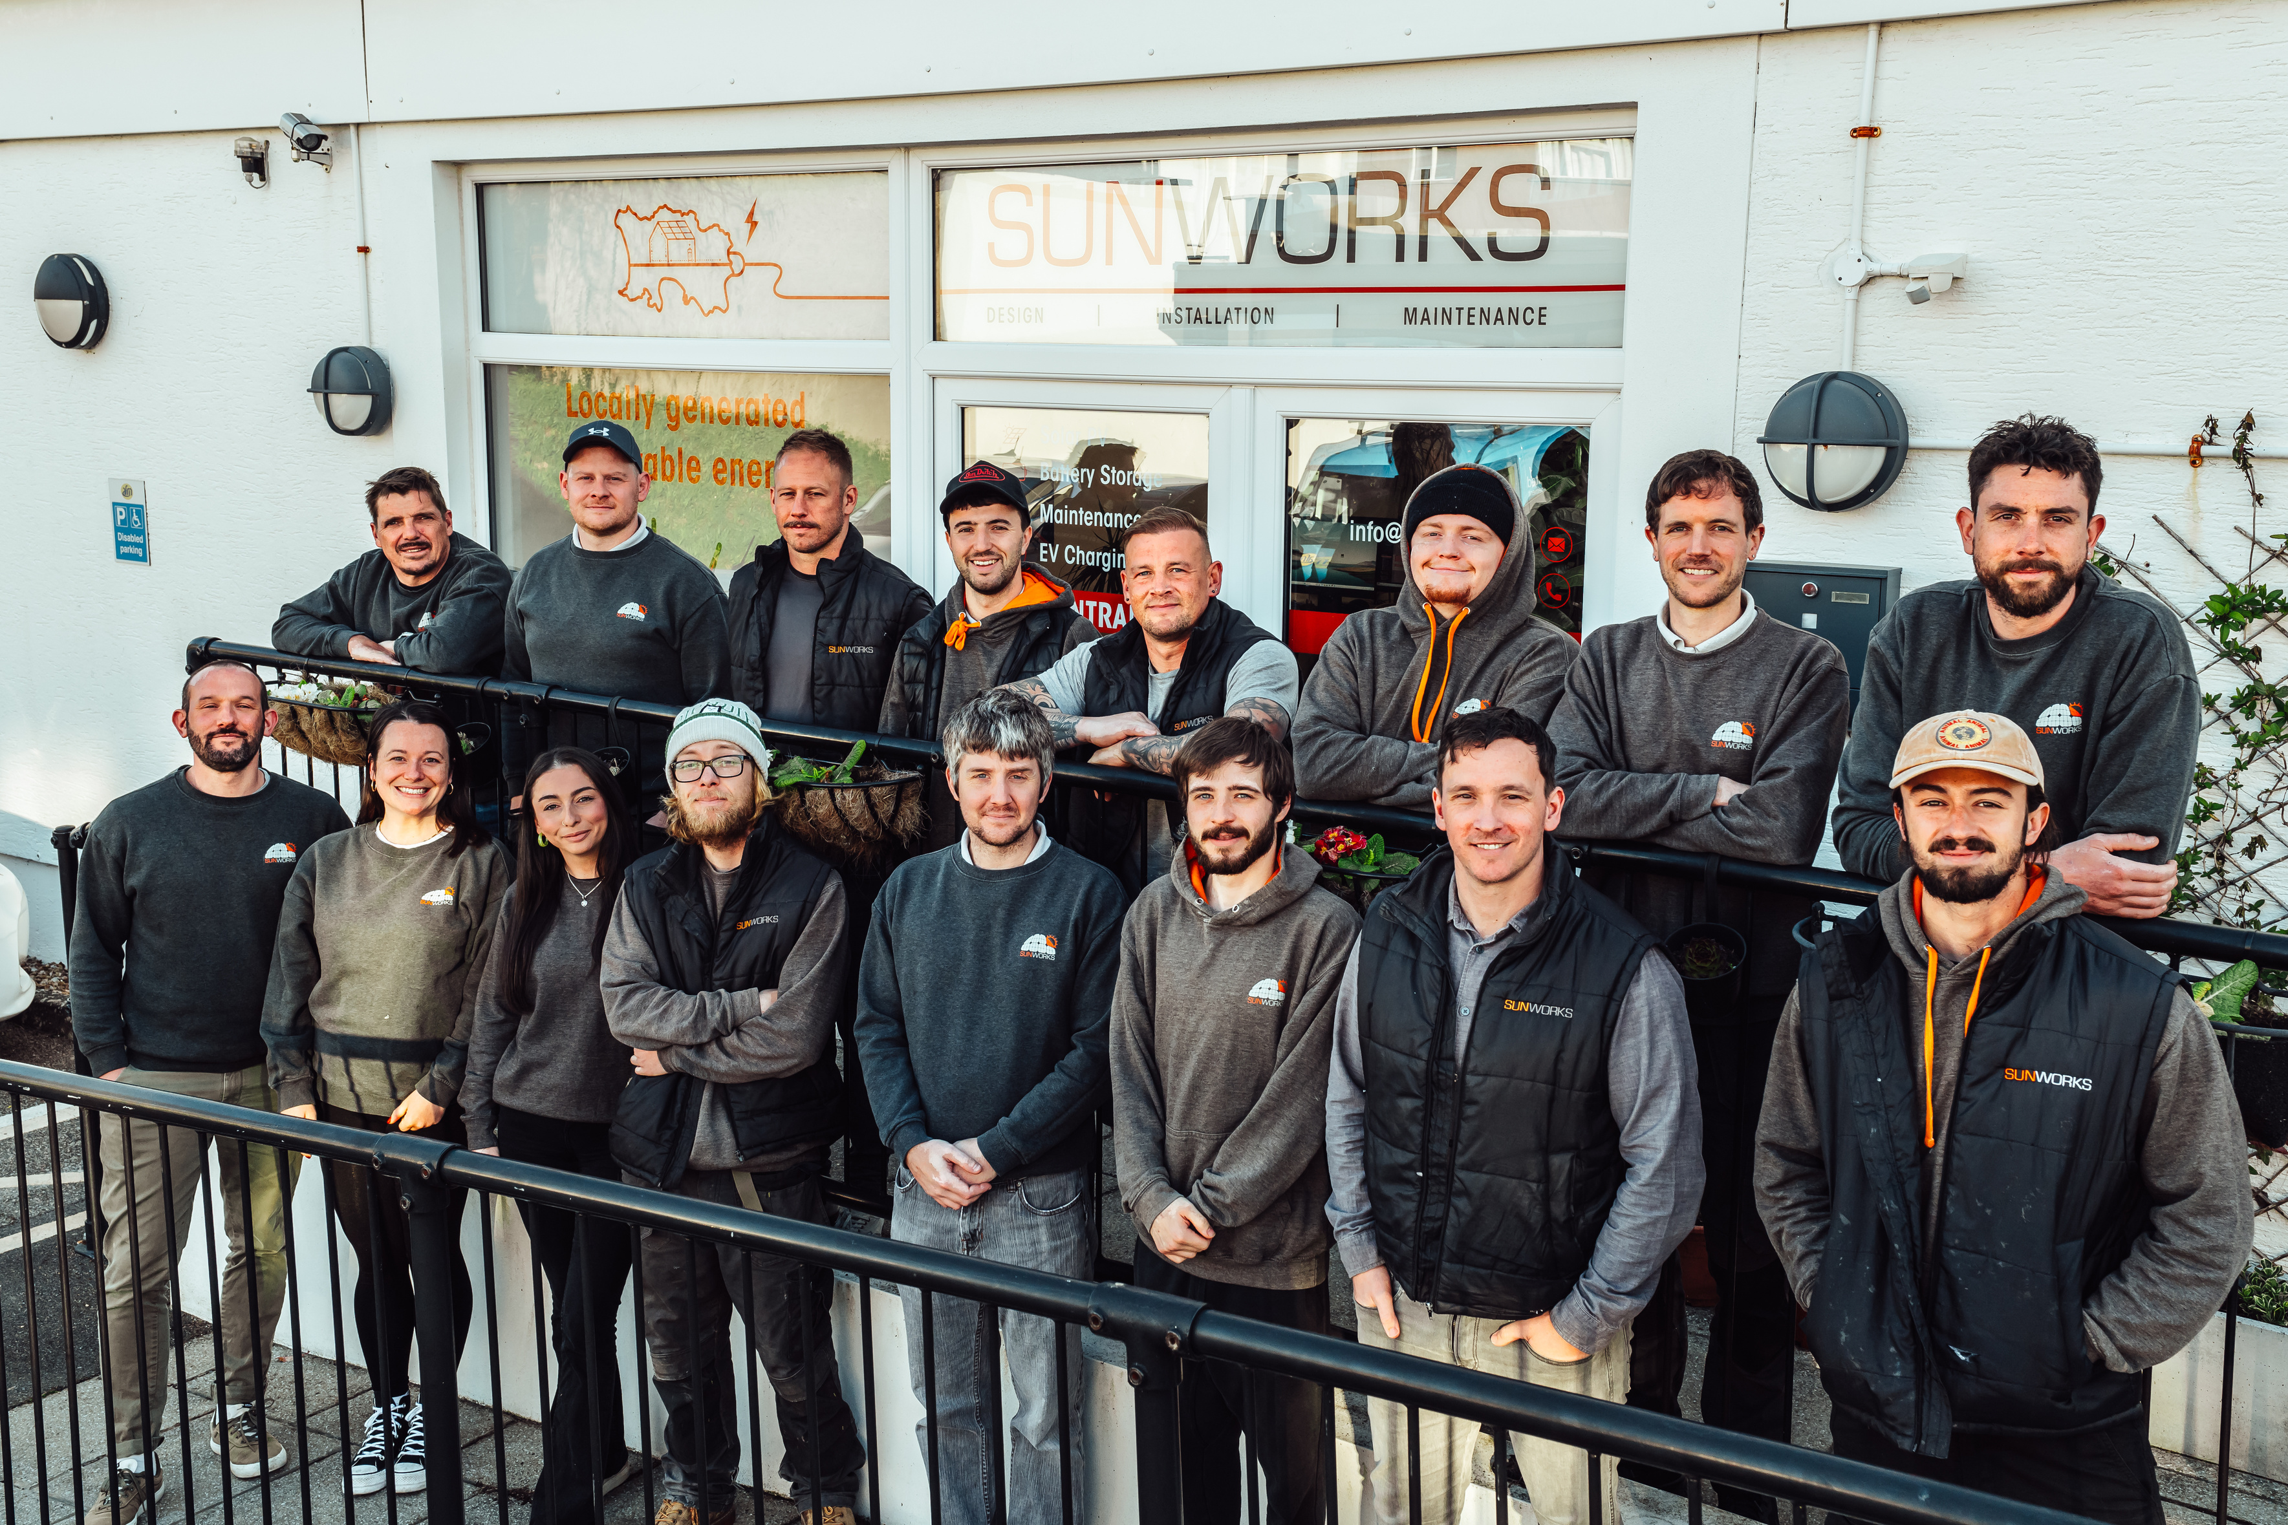
WHO WE ARE
Founded in 2013, SunWorks is Jersey’s leading solar energy company. We design and deliver high-quality solar installations for homes, businesses, and community projects, combining technical expertise with a passion for sustainability. With a focus on innovation, reliability, and local partnerships, SunWorks is helping shape a brighter, greener future for the Channel Islands.
600+ INSTALLATIONS COMPLETE AND COUNTING
16,000+ SOLAR PANELS INSTALLED
1,800 HOMES POWERED BY SUNSHINE
(01)

Slide 3
WHY WE STARTED THE GIVEAWAY
At SunWorks, we believe renewable energy should benefit everyone—not just those who can afford it. That’s why we launched the Community Solar Giveaway, an annual initiative designed to support local charities by gifting them high-value solar installations.
Our goal is to reduce energy costs, empower vital community services, and accelerate Jersey’s transition to clean energy. By combining public engagement, industry collaboration, and volunteer spirit, we’re making sustainability more inclusive—one rooftop at a time.
2 COMPLETED SOLAR GIVEAWAY INSTALLATIONS TO DATE
34 SOLAR PANELS INSTALLED
64 FREE WORKING HOURS DONATED BY THE SUNWORKS TEAM
(02)
2 SCAFFOLDS DONATED BY SMART SCAFFOLDING LTD

Slide 4
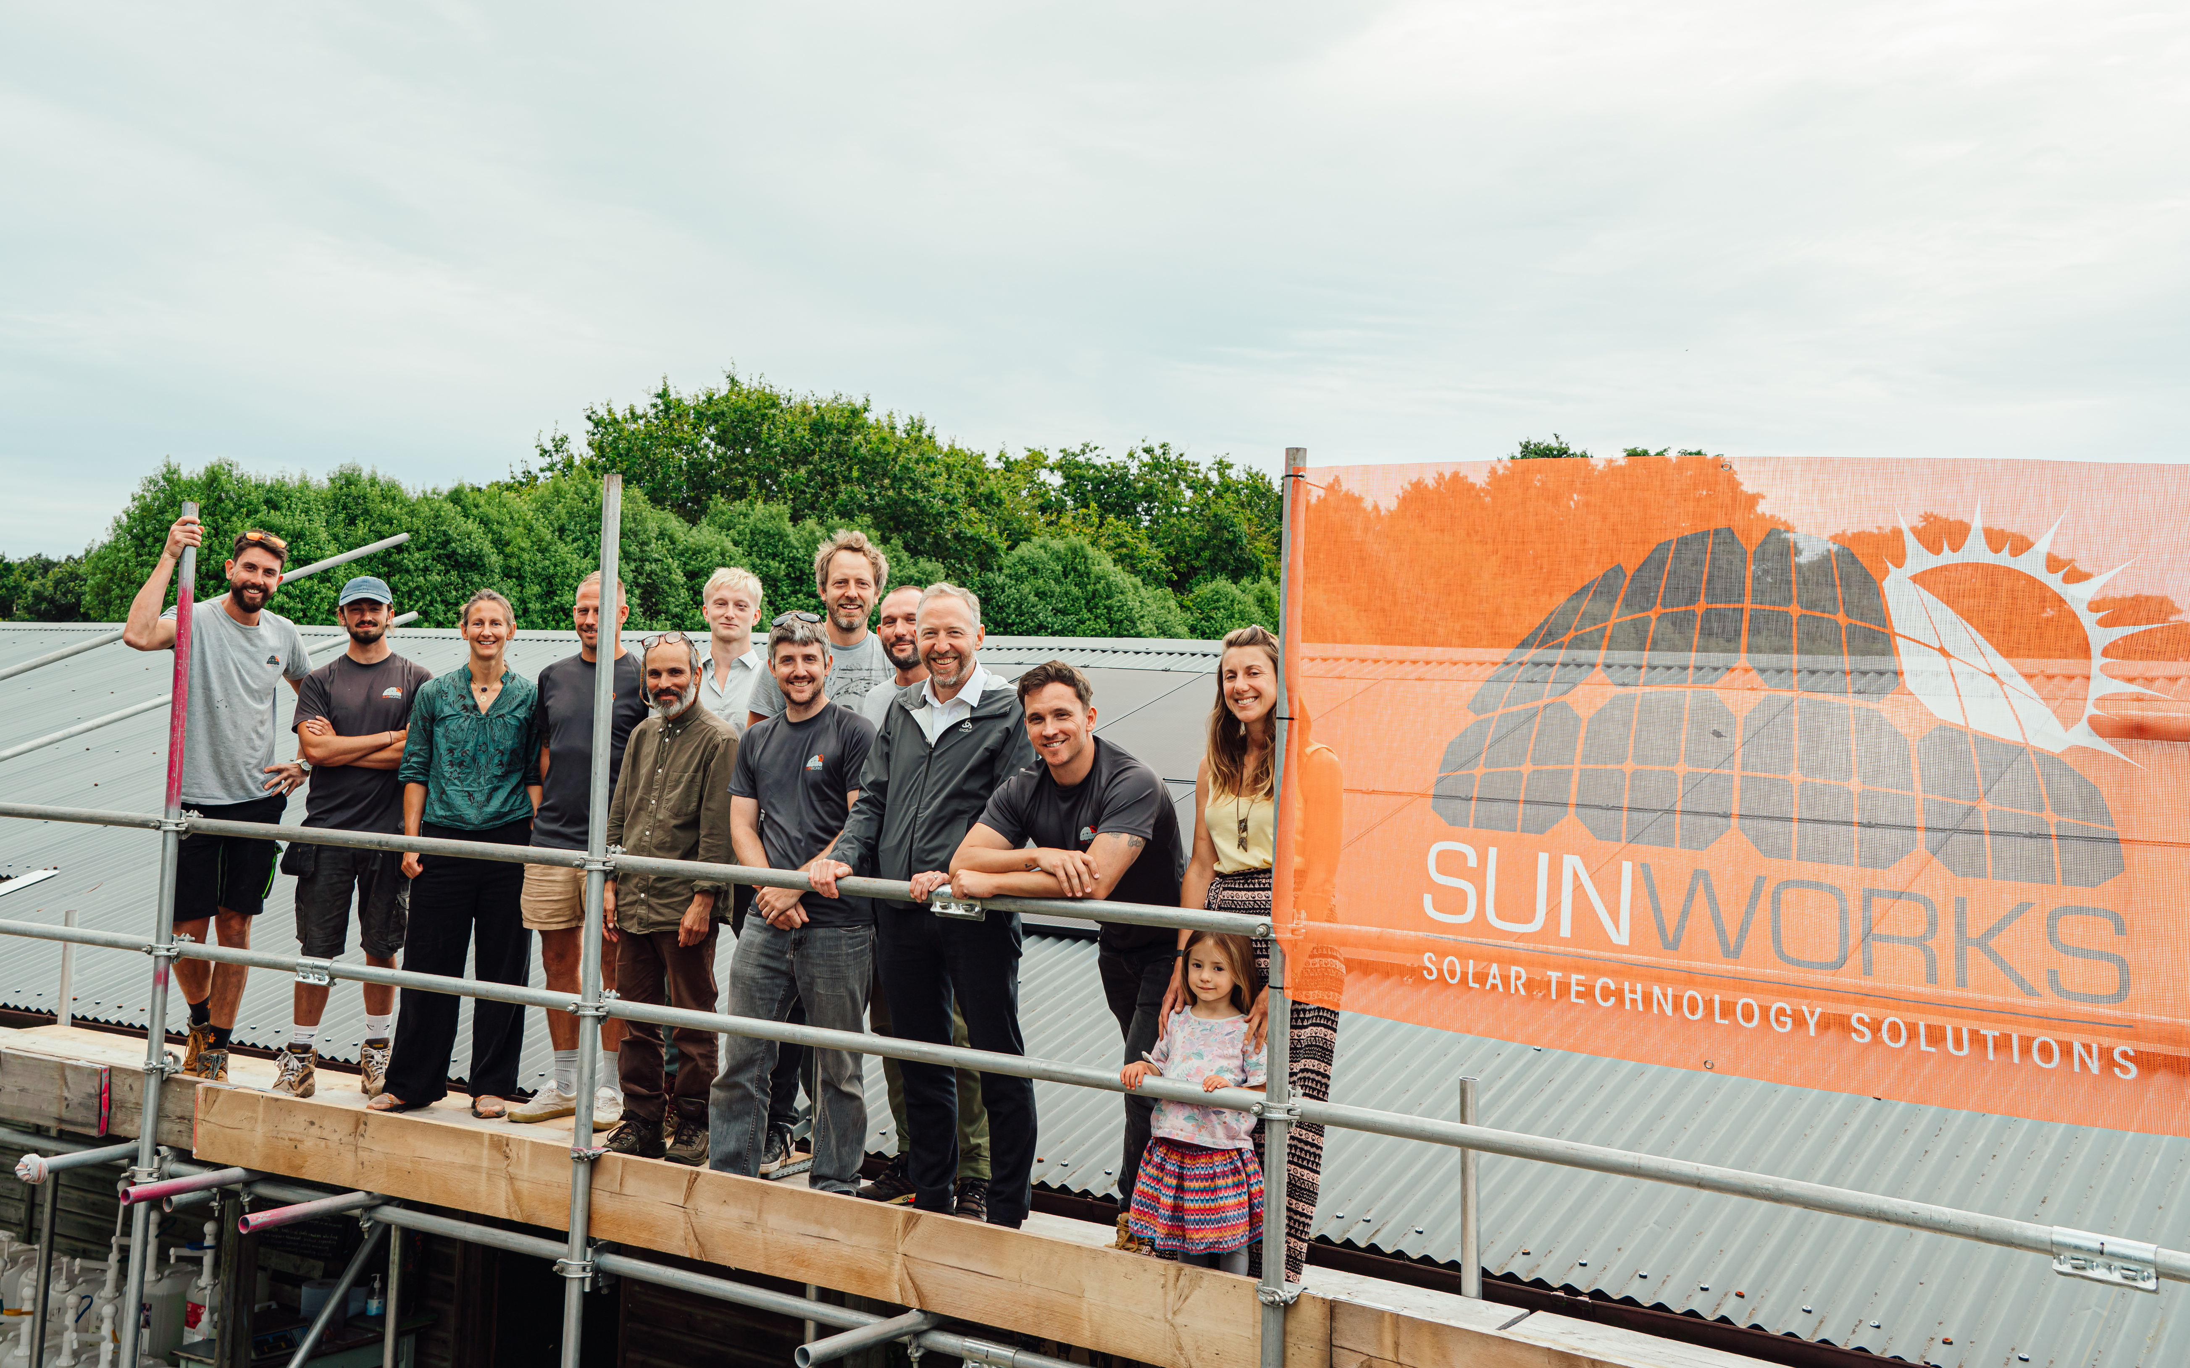
PAST WINNERS
2024
As part of our commitment to community and sustainability, SunWorks donated a 5kW solar system valued at approximately £10,000 to SCOOP (the sustainable cooperative) through a public voting campaign.
Since installation, the system has generated over 2,470 kWh of clean energy, with 98% of the power directly used by SCOOP, resulting in £550 in electricity savings to date. The solar energy has enabled cold storage for organic produce, significantly reducing operational costs.
This initiative was made possible thanks to SMART Scaffolding’s generous service donation and the volunteer efforts of SunWorks staff, showcasing the power of collaboration in driving Jersey’s renewable future.
(03)

Slide 5
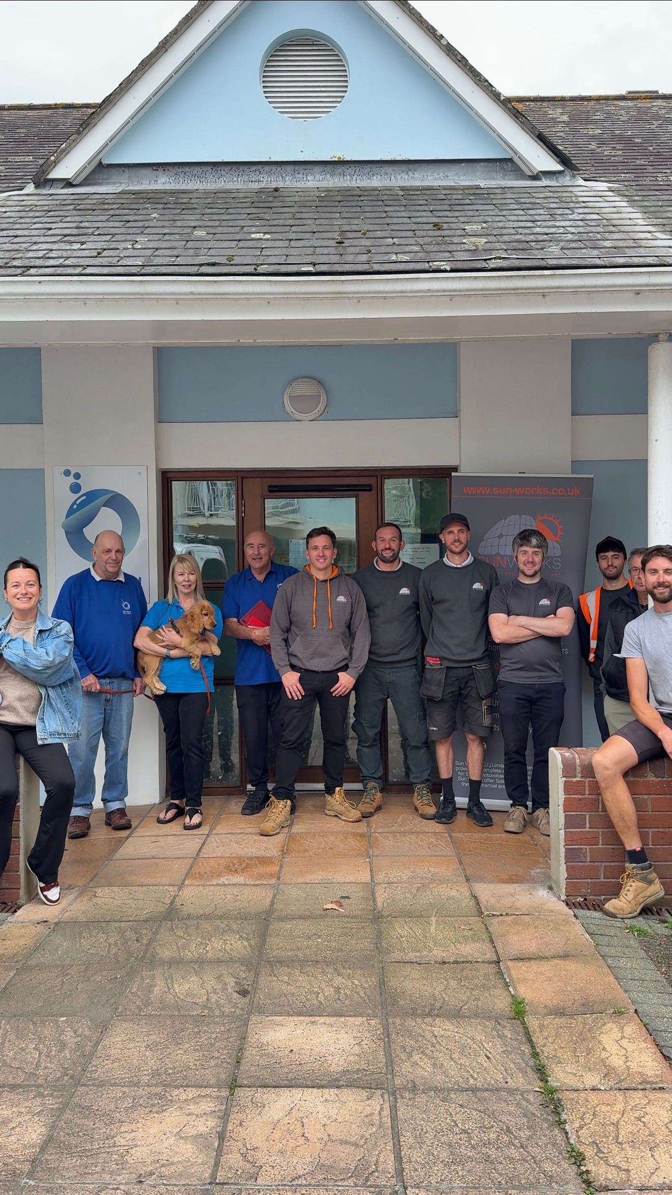
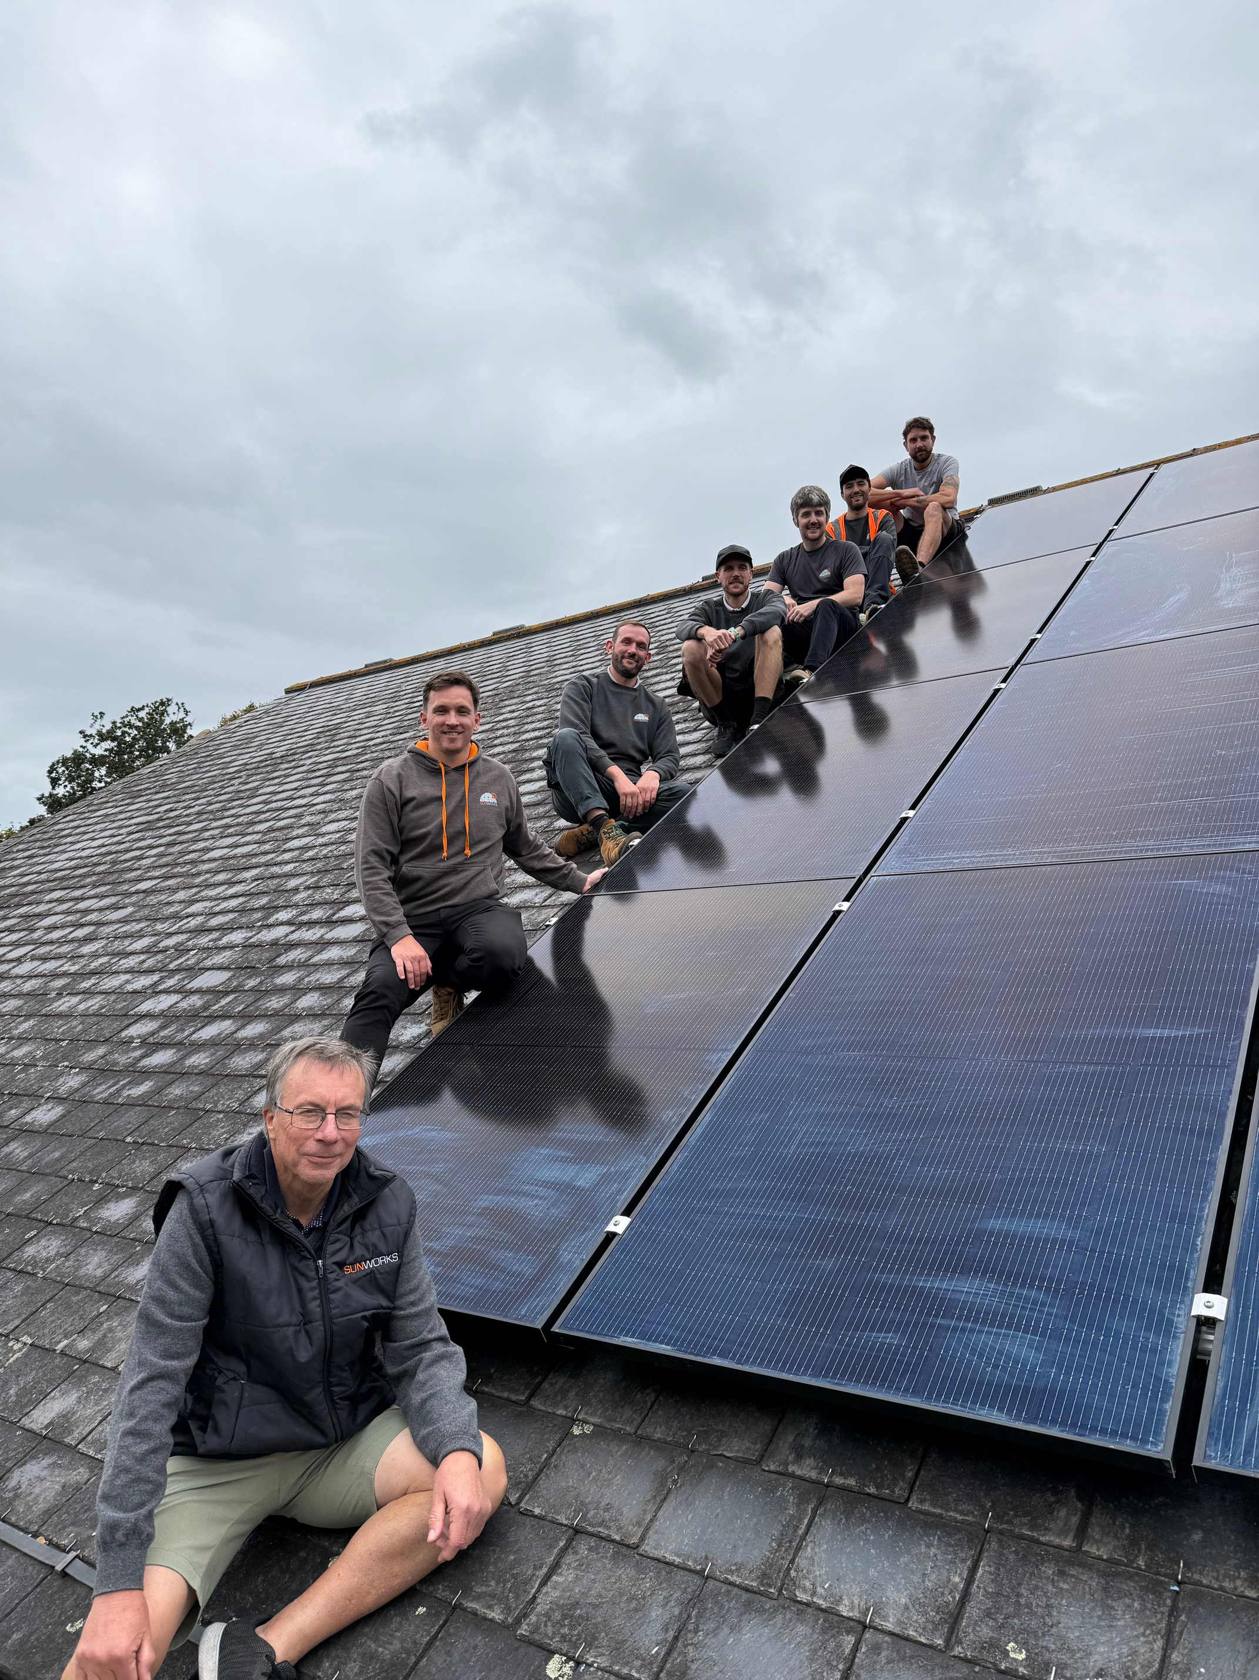
PAST WINNERS
2025
In our latest solar giveaway, SunWorks awarded a 7kW solar system worth £10,000 to the Oxygen Therapy Centre, a charity providing oxygen treatments for a range of health conditions.
Installed in September 2025, the system is designed to lower energy bills by 16% and reduce the charity’s environmental footprint, allowing more resources to be directed toward patient care.
The initiative received overwhelming public support through voting, with EYECAN named as the runner-up. This project reflects our mission to empower local organisations through clean energy, with community engagement and impact at its core.
(04)

Slide 6
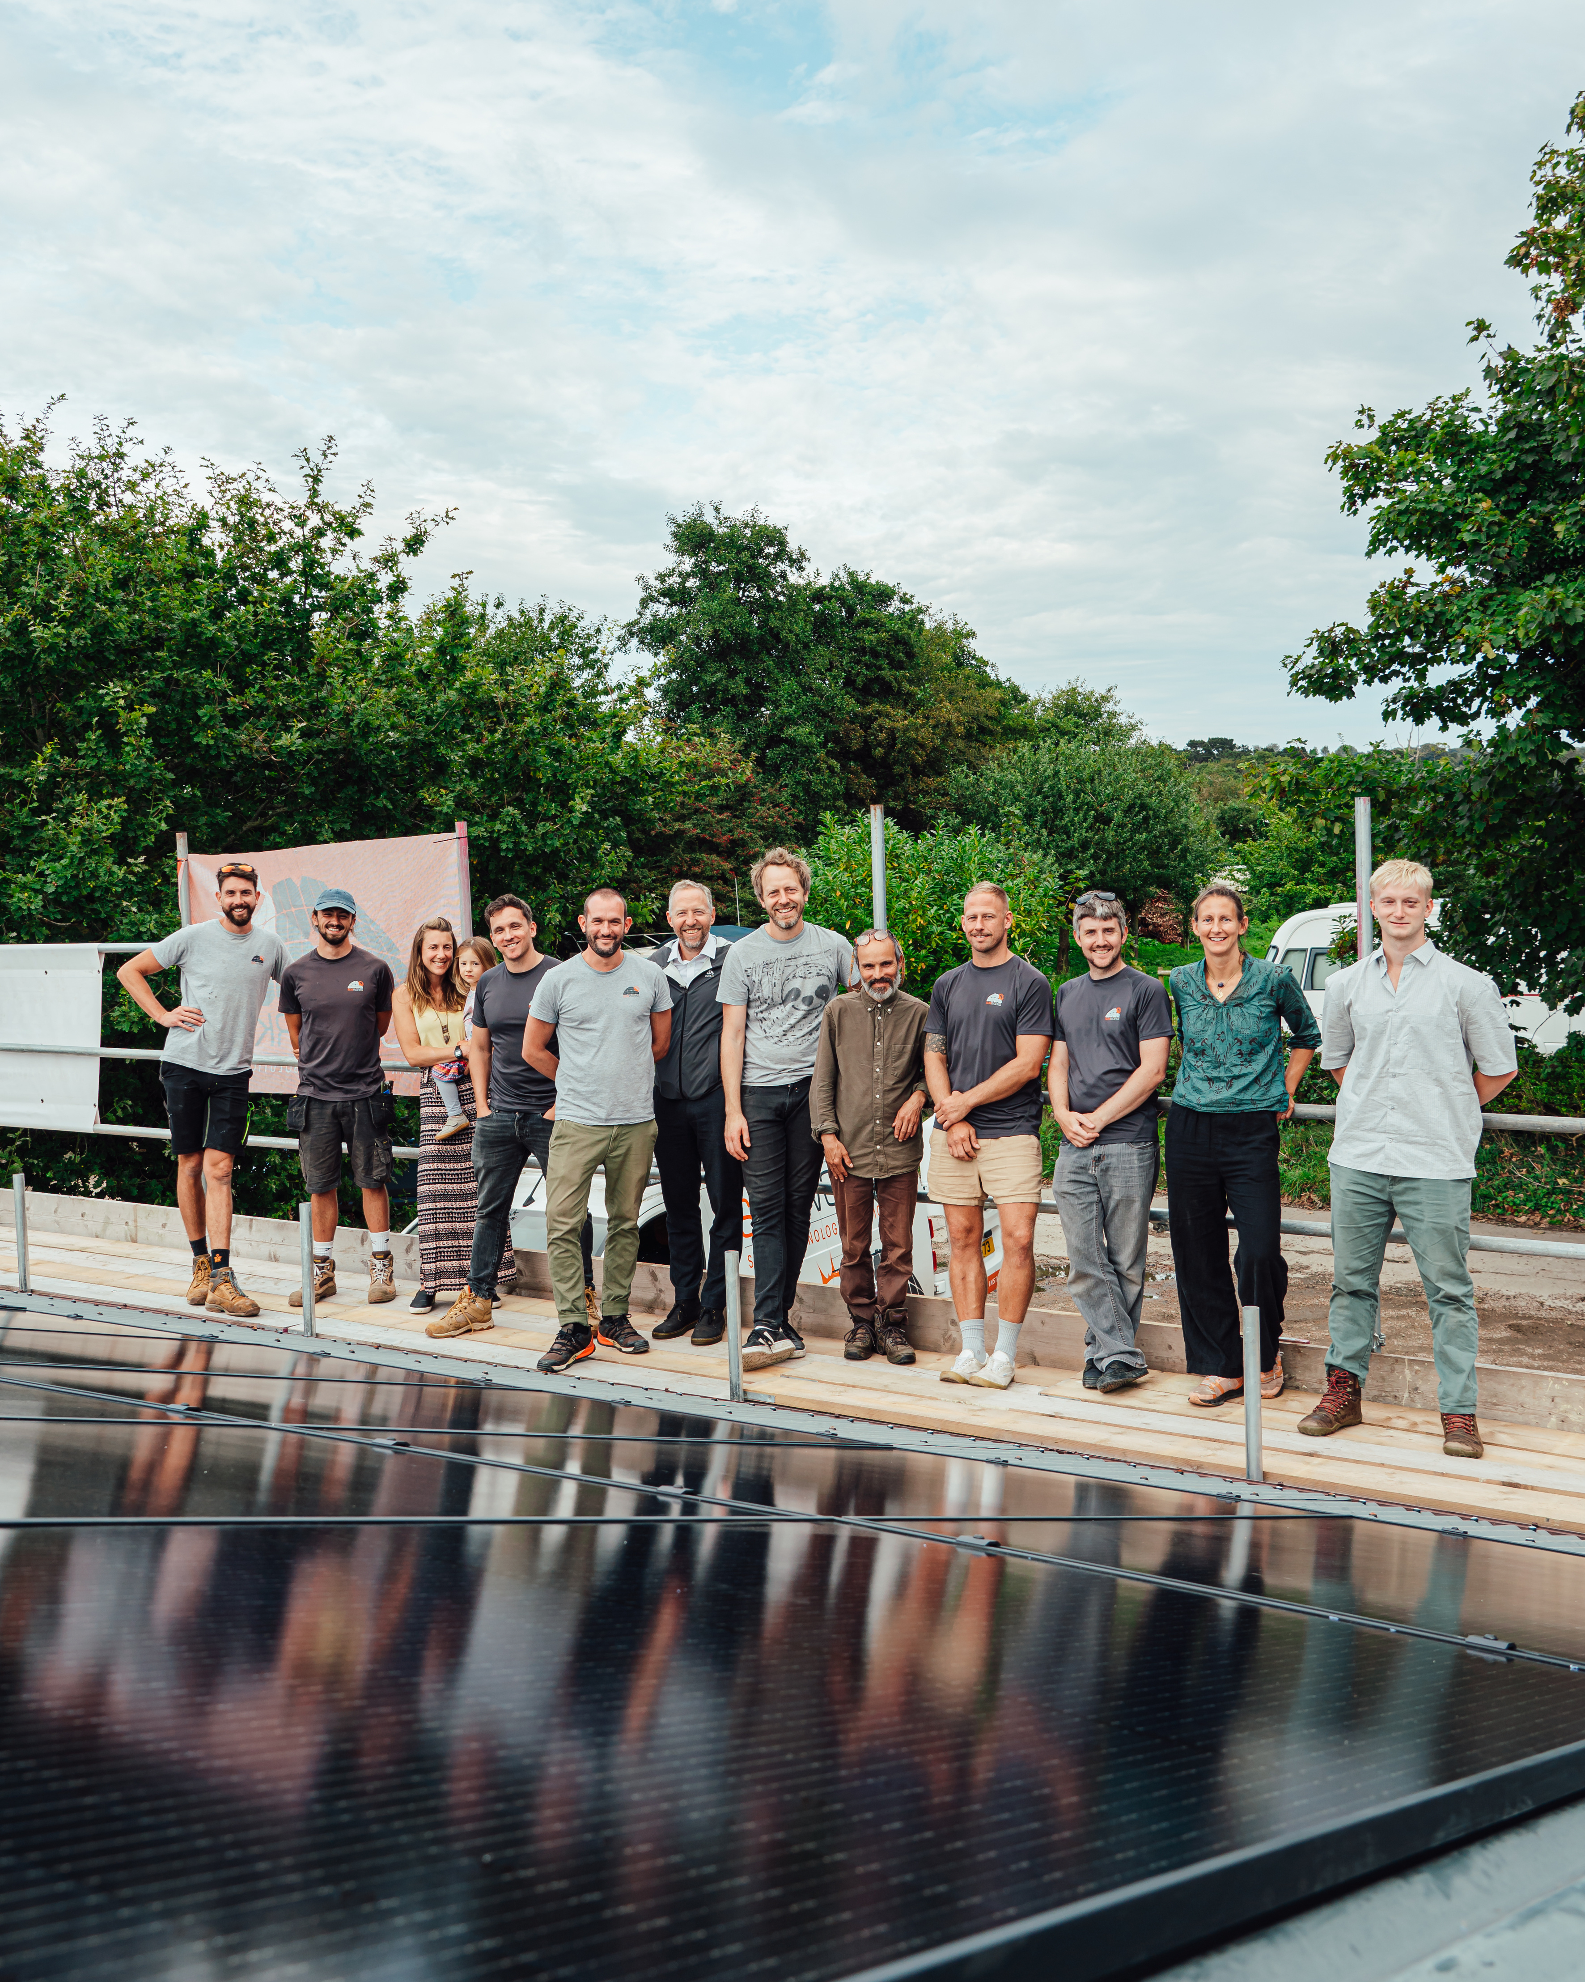
PARTNER WITH US
SunWorks has proudly delivered a community-focused solar giveaway for two consecutive years, gifting £10,000 solar installations to local charities in Jersey. These impactful projects have not only reduced energy costs and carbon footprints but also empowered organisations to reinvest savings into vital services—from organic food storage to patient care.
We are now seeking a co-sponsor for the 2026 edition, with partnership options of £5,000 or £10,000. Your contribution will directly enhance the scale, visibility, and impact of the giveaway, helping us reach more charities and amplify Jersey’s renewable energy movement. This is a unique opportunity to align your brand with sustainability, innovation, and community engagement—while making a tangible difference in the lives of islanders.
WHY?
AMPLIFY COMMUNITY IMPACT: YOUR CONTRIBUTION INCREASES THE VALUE OF THE GIVEAWAY, ALLOWING US TO OFFER LARGER OR MULTIPLE INSTALLATIONS.
BRAND VISIBILITY: CO-BRANDING ACROSS ALL CAMPAIGN MATERIALS, PRESS RELEASES, AND INSTALLATION EVENTS.
CSR ALIGNMENT: DEMONSTRATE YOUR COMMITMENT TO SUSTAINABILITY AND COMMUNITY WELLBEING.
(05)
ENGAGEMENT: BE PART OF A HIGH-VISIBILITY PUBLIC VOTING CAMPAIGN THAT ENERGIZES LOCAL SUPPORT.

Slide 7
EXPIERIENCE & OPPORTUNITIES
SOLAR TASTER DAY
On the day of the Solar Giveaway installation, give your team a ‘day in the life’ of a SunWorks crew member. The Sponsor team *limited to numbers and responsibilities for safety reasons joins us on the day of the installation to help the team, meet & greet with the winners, to gain a true insight of all the magic behind the scenes.
BRAND RECOGNITION
We can make the winner reveal and installation events bigger and better, together! Over the two events (online and in-person) you will receive full branding and media coverage as our lead sponsor for the giveaway. Naming rights “SunWorks Solar Giveaway, Powered with ‘your company name’”
COMMUNITY STORY INTEGRATION
Your company logo on videos documenting the winner’s journey and installation process, spread across all forms of social media through SunWorks and your company’s platforms as a partnership.
A chance to also provide a few words at the events, and interview for videos.
(06)

Slide 8
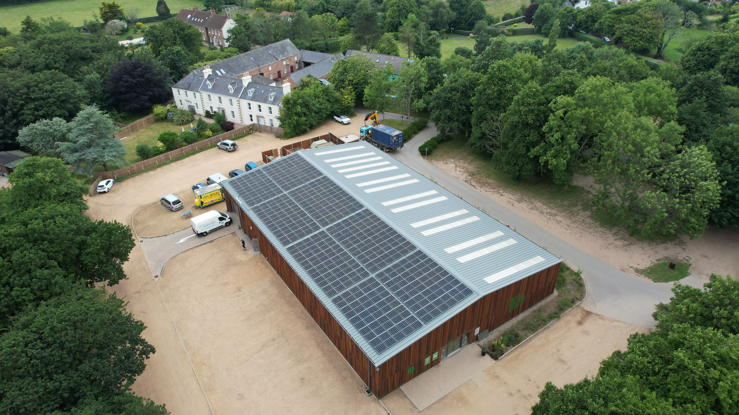
SPONSORSHIP OPTIONS
(07)
SILVER PACKAGE £5,000
FACILITATE INSTALLATION WORTH APPROXIMATELY £20,000
FULL CO-BRANDING, JOINT PR, SPEAKING OPPORTUNITY AT INSTALLATION EVENT, FEATURED IN CAMPAIGN VIDEO
GOLD PACKAGE £10,000
FACILITATE INSTALLATION WORTH APPROXIMATELY £30,000
FULL CO-BRANDING, JOINT PR, SPEAKING OPPORTUNITY AT INSTALLATION EVENT, FEATURED IN CAMPAIGN VIDEO

Slide 9
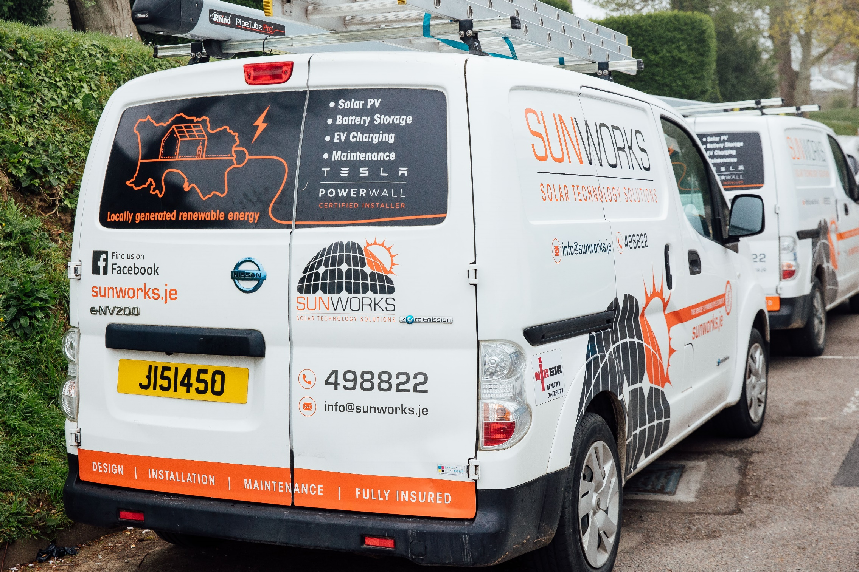
THANK YOU
(08)
JOIN US IN POWERING JERSEY’S FUTURE
PARTNER WITH SUNWORKS TO CO-SPONSOR THE 2026 COMMUNITY SOLAR GIVEAWAY AND MAKE A LASTING IMPACT.
YOUR SUPPORT WILL HELP DELIVER CLEAN ENERGY TO A LOCAL CHARITY, REDUCE CARBON EMISSIONS, AND STRENGTHEN COMMUNITY RESILIENCE.
WHETHER YOU CONTRIBUTE £5,000 OR £10,000, YOUR BRAND WILL BE RECOGNISED AS A PIONEER OF THE SOLAR COMMUNITY.

